Slide 1
JOURNEY PRESENTATION
AKSHAY P

Slide 2
Day 1 – Agile software Development
"Agile process model" is a software development approach based on iterative development. Agile methods break tasks into smaller iterations. The project scope and requirements are laid down at the beginning of the development process. Plans regarding the number of iterations, the duration and the scope of each iteration are clearly defined in advance.
Scrum
SCRUM is an agile development process focused primarily on ways to manage tasks in team-based development conditions.
There are three roles in it, and their responsibilities are:
Scrum Master: The scrum can set up the master team, arrange the meeting and remove obstacles for the process
Product owner: The product owner makes the product backlog, prioritizes the delay and is responsible for the distribution of functionality on each repetition.
Scrum Team: The team manages its work and organizes the work to complete the sprint or cycle.
Scrum is the Framework in which a sprint takes place. A Sprint is a defined time period for developing features for a product. The maximum time for a sprint is 30 days (can be shorter but not longer).
What is Kanban?
Kanban is an Agile management method built on a philosophy of continuous improvement, where work items are “pulled” from a product backlog into a steady flow of work. The framework is applied using Kanban boards—a form of visual project management. This does not include the time frame of when and how quickly the tasks should be completed.

Slide 3
Day 2 – Agile software development
Waterfall Model methodology which is also known as Linear Sequential Life Cycle Model. Waterfall Model followed in the sequential order, and so project development team only moves to next phase of development or testing if the previous step completed successfully.
Limitations of Waterfall Model:
It is not an ideal model for a large size project
If the requirement is not clear at the beginning, it is a less effective method.
Very difficult to move back to makes changes in the previous phases.
The testing process starts once development is over. Hence, it has high chances of bugs to be found later in development where they are expensive to fix.
When to use the Agile Model?
When frequent changes are required.
When a highly qualified and experienced team is available.
When project size is small.
Advantage of Agile Method:
Frequent Delivery
Efficient design and fulfils the business requirement.
Anytime changes are acceptable.
It reduces total development time.

Slide 4
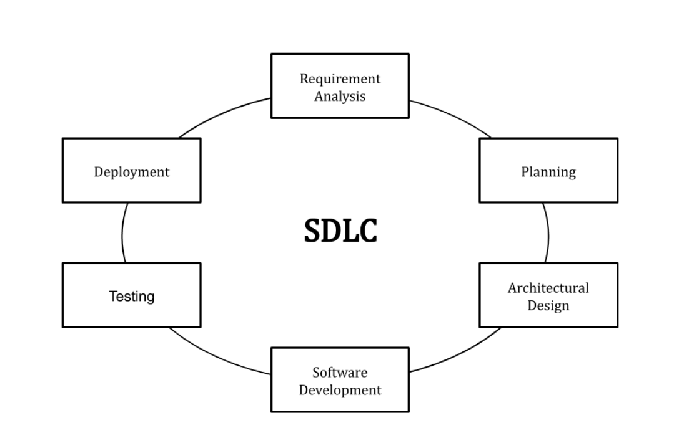
Day 3 – Software Testing
What is the software development life cycle?
SDLC or the Software Development Life Cycle is a process that produces software with the highest quality and lowest cost in the shortest time possible. SDLC provides a well-structured flow of phases that help an organization to quickly produce high-quality software which is well-tested and ready for production use.
Advantages of the software development life cycle:
Efficient with regard to costs
Efficacious in terms of time
Enhances teamwork and coordination, defines suitable roles for employees and increases workplace transparency.
Minimal danger when the project is implemented

Slide 5
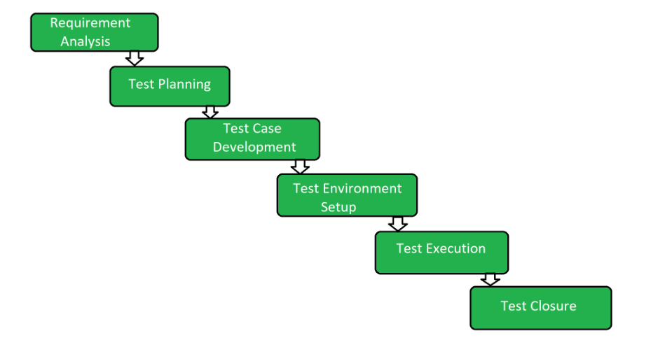
What is the software testing life cycle?
The Software Testing Life Cycle (STLC) is a systematic approach to testing a software application to ensure that it meets the requirements and is free of defects.
The main goal of the STLC is to identify and document any defects or issues in the software application as early as possible in the development process. This allows for issues to be addressed and resolved before the software is released.
Benefits of software testing:
Cost-Effective: Testing any IT project on time helps us save money in the long term. In case bugs are caught in the earlier stage of software testing, it costs less to fix.
Low Failure: Failure of an application impacts its working and brand value. Software testing helps in knowing the cases where a particular application is most likely to fail.
Speeds Up Development: Testing an application early in the development cycle can help identify issues that would otherwise take longer to fix later.

Slide 6
Day 4 – Database management system
What Is a Query?
A database query is a request for data from a database. The request should come in a database table or a combination of tables using a code known as the query language.
Some of the most used query commands:
SELECT – fetch data from the database. It’s one of the most popular commands, as every request begins with a select query.
AND – combine data from one or more tables.
CREATE TABLE – build different tables and specify the name of each column within.
ORDER BY – sort data results either numerically or alphabetically.
SUM – summarize data from a specific column.
UPDATE – modify existing rows in a table.
INSERT – add new data or rows to an existing table.
WHERE – filter data and get its value based on a set condition
SQL - Subquery
In SQL a Subquery can be simply defined as a query within another query.
Ex: Select NAME, LOCATION, PHONE_NUMBER from DATABASE WHERE ROLL_NO IN (SELECT ROLL_NO from STUDENT where SECTION=’A’);

Slide 7
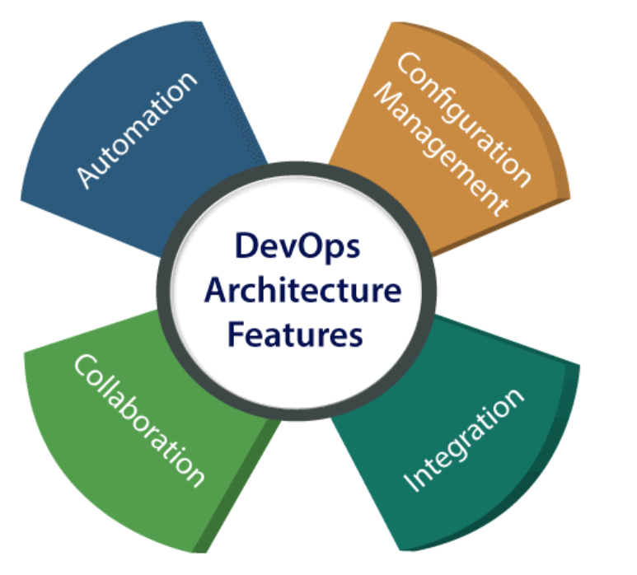
Day 5 – DevOps
What is DevOps?
The DevOps is a combination of Software Development and Operations. This allows a single team to handle the entire application lifecycle, from development to testing, deployment, and operations. DevOps helps us to reduce the disconnection between software developers, quality assurance (QA) engineers, and system administrators.
Advantages
DevOps is an excellent approach for quick development and deployment of applications.
It responds faster to the market changes to improve business growth.
DevOps escalate business profit by decreasing software delivery time and transportation costs.
DevOps clears the descriptive process and gives clarity on product development and delivery.
It improves customer experience and satisfaction.
DevOps means collective responsibility, which leads to better team engagement and productivity.

Slide 8
Day 6 – Cloud COmputing
What is Cloud Computing
The term cloud refers to a network or the internet. It is a technology that uses remote servers on the internet to store, manage, and access data online rather than local drives. The data can be anything such as files, images, documents, audio, video, and more.
Three types of cloud computing services:
Infrastructure as a service (IaaS) offers on-demand access to IT infrastructure services, including compute, storage, networking, and virtualization. It provides the highest level of control over your IT resources and most closely resembles traditional on-premises IT resources.
Platform as a service (PaaS) offers all the hardware and software resources needed for cloud application development. With PaaS, companies can focus fully on application development without the burden of managing and maintaining the underlying infrastructure.
Software as a service (SaaS) delivers a full application stack as a service, from underlying infrastructure to maintenance and updates to the app software itself. A SaaS solution is often an end-user application, where both the service and the infrastructure is managed and maintained by the cloud service provider.
Advantages of Cloud Computing:
It’s cost-effective
Scalability and flexibility
Easy to Back-up and restore data
Reliable and quickly deployable

